Slide 1

ATAX Problem Optimization
Assignment 2 – Team 4
Davide Buchignani – Francesco Caligiuri - Luca Di Leo

Slide 2
ATAX
The process of ATAX involves the multiplication of the matrix A, its transpose, and the vector x. This operation is fundamental in linear algebra for various computational tasks.
y = A^{T} A x

Slide 3
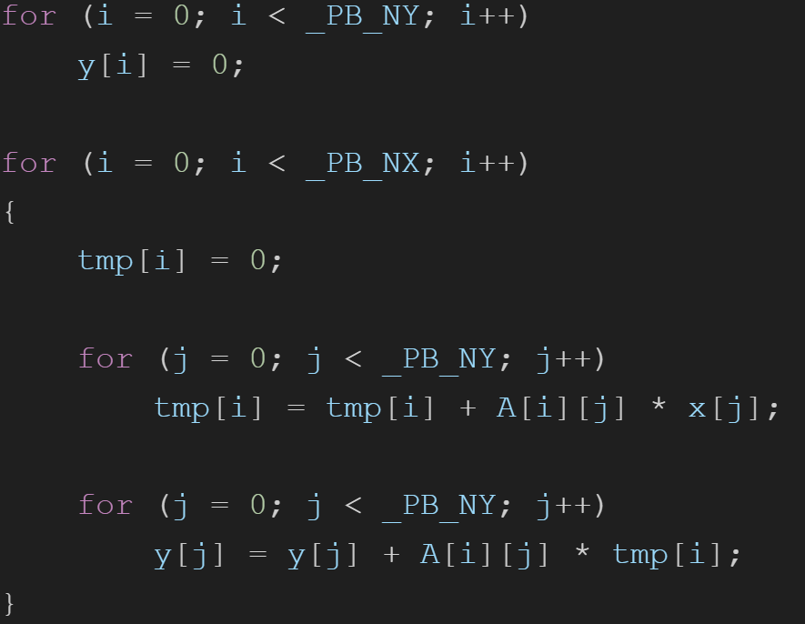
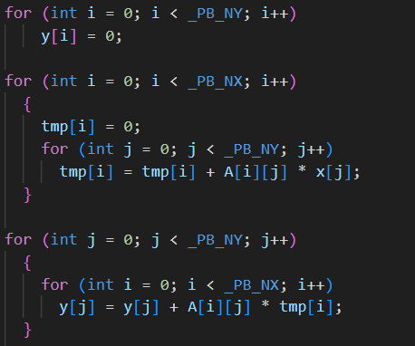
Code
Initialization of solution vector y
Computation of tmp = A ⋅ x
Computation of y = A^{T} ⋅ tmp

Slide 4
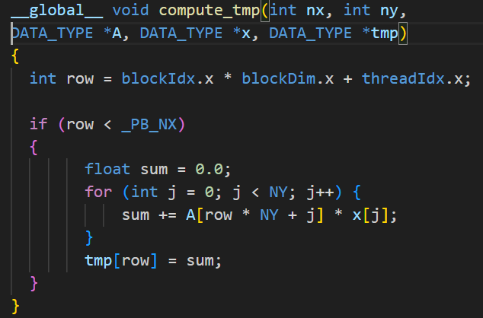
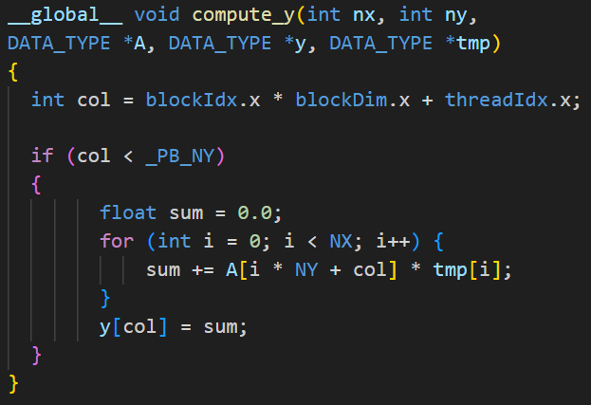
Our Kernels:
Plus another version using the shared memory for the vector x and tmp

Slide 5
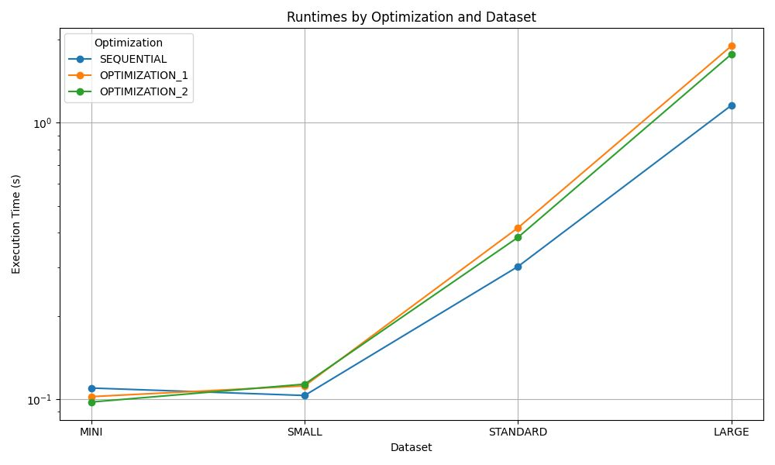
RESULTS COMPARISON

Slide 6
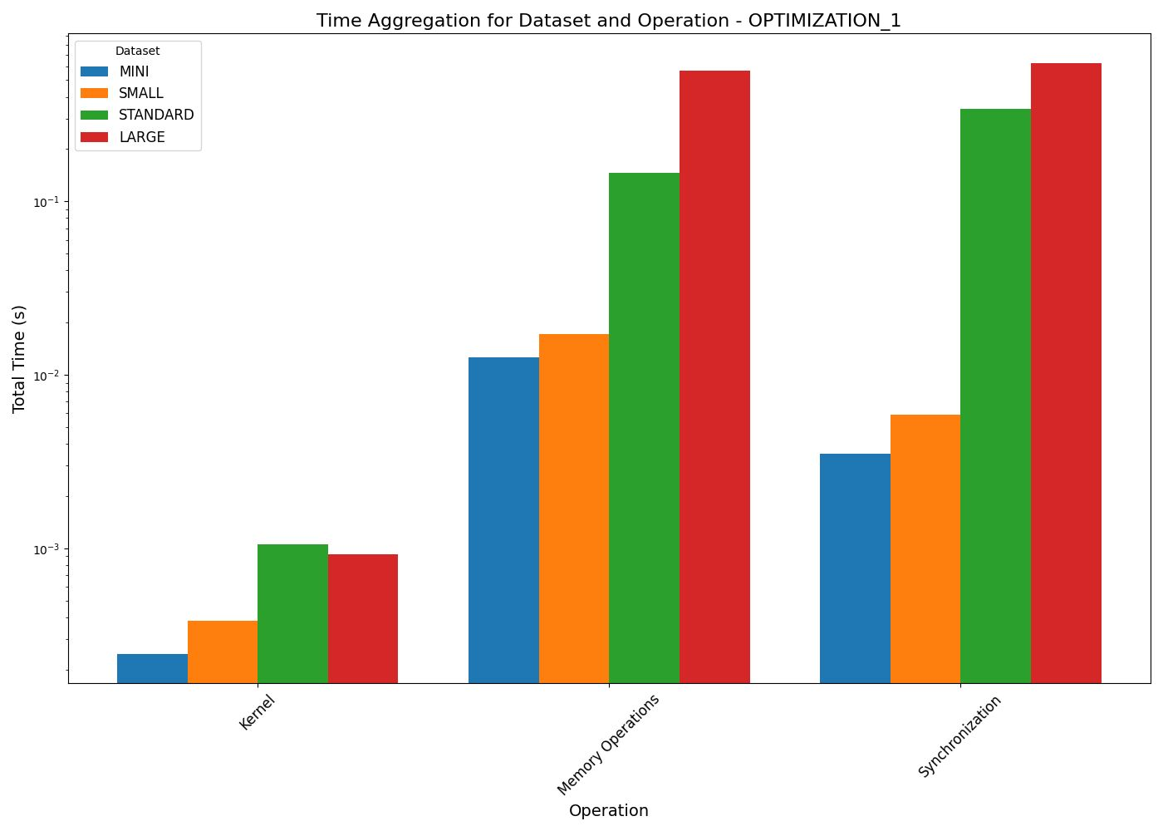

Slide 7
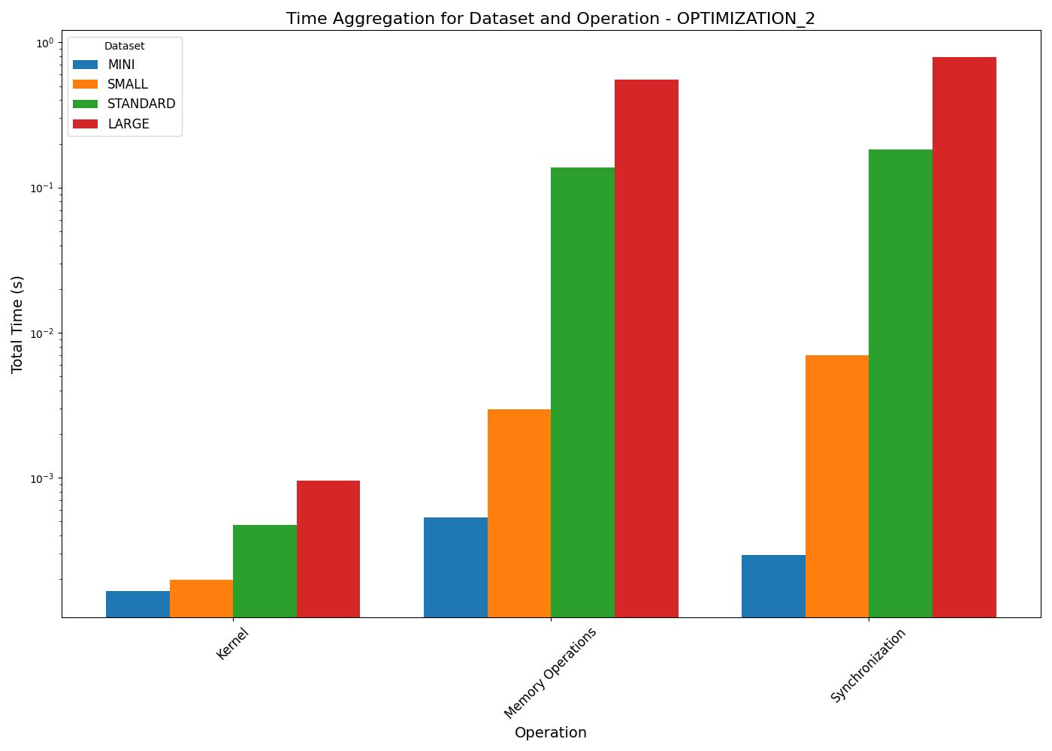

Slide 8
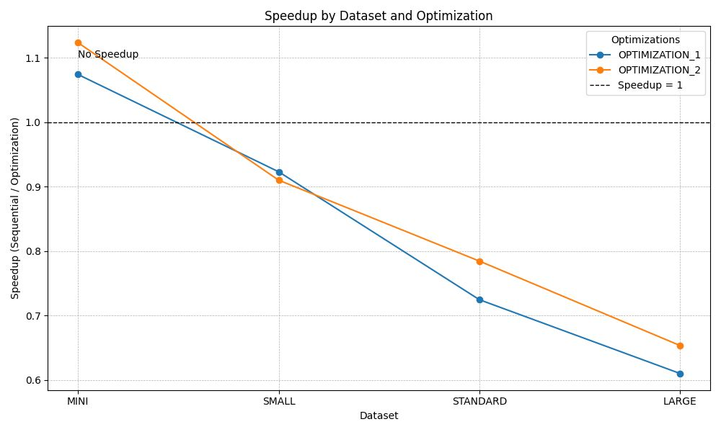
SPEEDUP ACHIEVED

Slide 9
Conclusions
Sub-par speedup
Our solution did not achieve an adeguate speedup on the sequential version

Slide 10
Unnecessary memory operations.
We think the reason for this is the way we access the matrix A In the Compute_Y kernel: by accessing the columns of the matrix without taking advantage of the locality of the data, either by tiling or by altering the order of the accesses, we limit the potential speedup of the kernel
Possible Causes

Slide 11
Possible Solutions
Effective Tiling:
By using partial sums and tiling of the matrix, we can reduce the
memory-bound time that our current solution has.
Alternative Access:
We could also change the way we access the transposed matrix in
order to try and use the memory more effectively

Slide 12
Thank you for your attention

